Slide 1
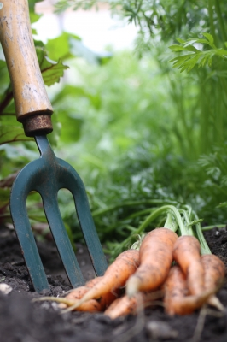
VEGETABLES

Slide 2
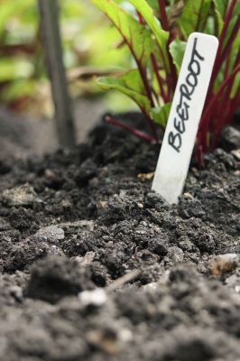
ORIGIN
Vegetables are from Plants
They are the edible parts of
a plant.

Slide 3
CLASSIFICATION
Usually categorised to the part of plant that is used as a food:
Bulbs- onions, garlic, leeks, spring onions
Root s- carrots, parsnip, beetroot
Tubers- potatoes, sweet potatoes
Leaves- cabbage, lettuce, spinach, Brussels sprouts
Stems- asparagus, celery
Flowers- Broccoli, cauliflower
Seeds and Pods- beans, green peas, snow peas, sweet corn
Fruits- tomato, cucumber, pumpkin, zucchini
Fungi- mushrooms
Shoots and sprouts- bamboo, bean, mung bean sprouts.

Slide 4
QUALITY CONSIDERATIONS
Deferent Vegetables have different considerations of quality and storage for example:
Green leafy vegetables should be bright and crisp, feel firm with a bright green colour.
They should be kept in a plastic bag and stored in the vegetable section of the refrigerator.

Slide 5
Chemical Properties
Vegetables are very nutrient dense including:
Carbohydrates- more starch dense than sugar.
Dietary fibre
Vitamins such as A, C and folate
Minerals including iron, magnesium, zinc and calcium
Also 70-97% Water!

Slide 6
SENSORY, PHYSICAL PROPERTIES
All vegetables look different:
Describe: Bok Choy
Tomato
Garlic
Corn
The sensory and physical properties can be changed to suit different needs e.g. canning, freezing.

Slide 7
CHEMICAL PROPERTIES
Major changes take place when we cook vegetables to the texture, flavour, colour and nutritional composition.

