Slide 1
Vegetables

Slide 2
Classification of Vegetables
Webster’s dictionary refers to vegetables as “any plant,” but more specifically as those that are edible.
The part of the plant used as a vegetable often serves as a common method of classification.
Vegetables may be derived from almost any part of a plant:
Roots
Bulbs
Stems
Leaves
Seeds
Flowers

Slide 3
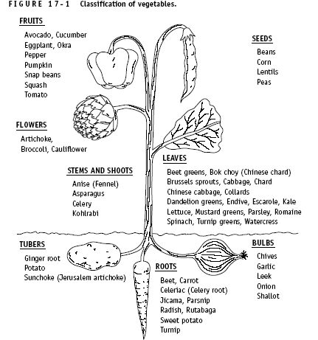

Slide 4
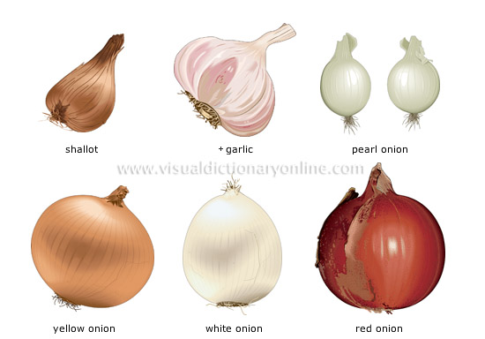
BULBS
Bulb vegetables are aromatic vegetables that are widely used to flavour casseroles, broths and soups. Some bulb vegetables, garlic for example, are also known for their medicinal virtues.

Slide 5
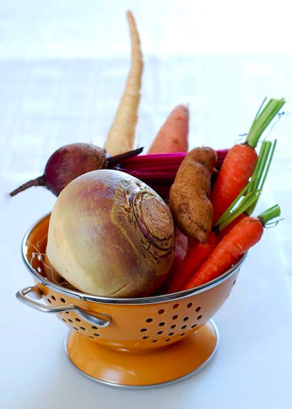
ROOT VEGETABLES
A root vegetable is one where the root is eaten, not the actual plant. Beets, carrots, turnips and parsnips are al examples.

Slide 6
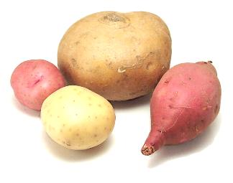
TUBERS
The tuber is the enlarged tip of an underground stem.The plant uses this tip to store food.
Eg: Potato, Sweet Potato, Yams

Slide 7
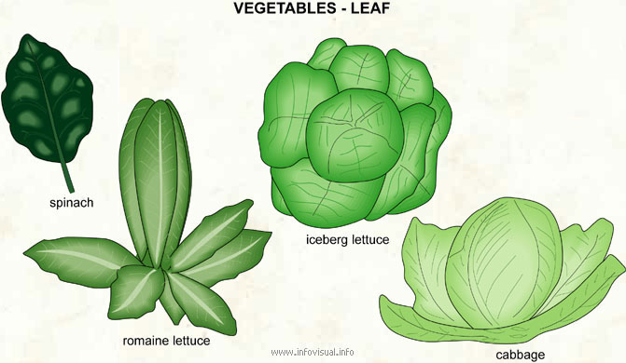
LEAF VEGETABLES
A leaf vegetable is one that is grown for its edible leaves. Most leaf vegetables are a good source of potassium and vitamins A and C. They are very versatile and can be prepared raw or cooked, in salads, as vegetable side dishes or added to recipes.

Slide 8
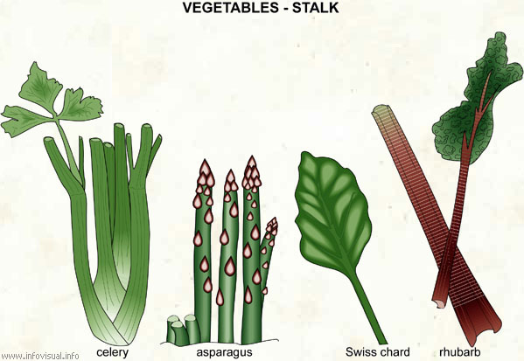
STEM VEGETABLES
Stem vegetables are those that have stems which can be consumed. Some of the most popular stem vegetables include asparagus, celery and fennel. These vegetables can be used to make a variety of dishes.
It is important to remember that stem vegetables should not be over-cooked, or else they may lose their crunchiness.

Slide 9
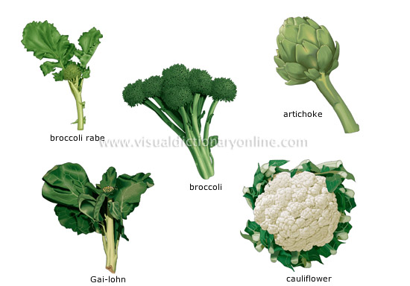
FLOWER VEGETABLES
Flower vegetables are so called because they have the shape of flowers. They are usually small in size and appear like many flower buds clustered together.

Slide 10
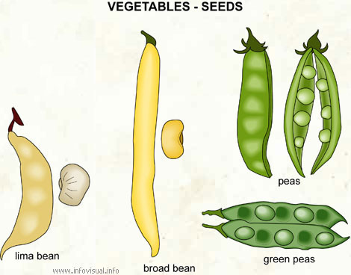
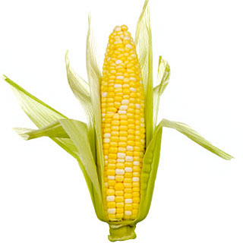
SEEDS AND PODS
Podded vegetables, popularly known as legumes, are seeds that are found inside pods.
In the olden days, legumes were known as the poor man's food. However, with the passing years, they have been included in the diet of most people.
Podded vegetables are a great source of protein which helps in providing the energy and strength required to carry out daily activities. They also contain potassium, folic acid, complex carbohydrates, magnesium, iron, fiber and zinc.

Slide 11
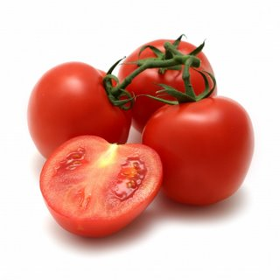
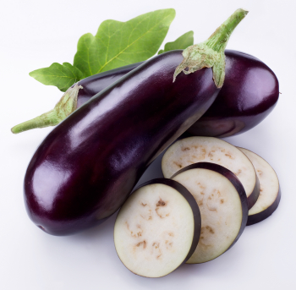
FRUIT VEGETABLES
Fruit vegetables are so called because botanically they fulfill the definition of fruits, but are used as vegetables by human beings.
They are considered to be fruits because in the scientific sense of the term, fruits are those that carry the seeds of the plant. So, tomatoes, cucumber etc which are consumed as vegetables are actually fruits because they have seeds in them.

Slide 12
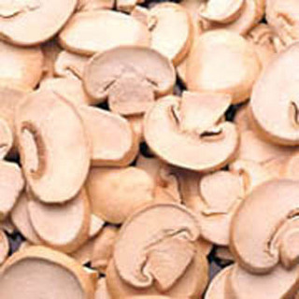
FUNGI
The mushroom that we eat is in fact the fruiting body of the plant which, in its natural state, would be used to spread the spores as a means of reproduction.
Mushrooms do not have stems, branches, roots, leaves or flowers and are not able to produce their own food via photosynthesis.

Slide 13
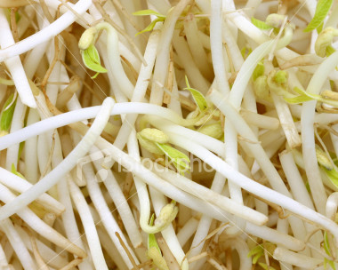
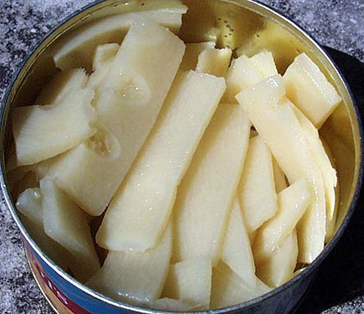
SHOOTS AND SPROUTS
Legumes and seeds produce sprouts. These are the tips of the plant as it begins to grow.

Slide 14
Fill out the following table about the physical, sensory, chemical properties of the listed vegetables
What few vegetables contain fat (these are still good fats)?
 | Classification Of vegetable | Physical-In peak condition | Vitamins /nutrients/ Minerals/ | Functional properties | Possible cooking methods
Floury Potatoes
Broccoli
Carrots
Spinach
Celery
Tomatoes
Sweet corn

Slide 15
Make a reminder list of the role or function of the listed nutrients in our bodies
Carbohydrates
Protein
Fat
Vitamin A( dark green and orange vegetables)
Vitamin B( found in green leafy vegetables)
Vitamin C( found in red vegetables, capsicum, tomato and broccoli ,cauliflower)
Vitamin D
Minerals-Calcium ,Magnesium, Folate, Iron

