Slide 1
Food and Technology unit 2
Tools, equipment and gadgets
Choosing correct tools and equipment for the task
This ensures the food handler is able to optimise the quality of food product
Using a blunt knife is a safety hazard
Using a rusty cake tin is a health hazard

Slide 2
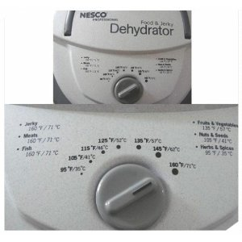
Tools, equipment and gadgets
What is this

Slide 3
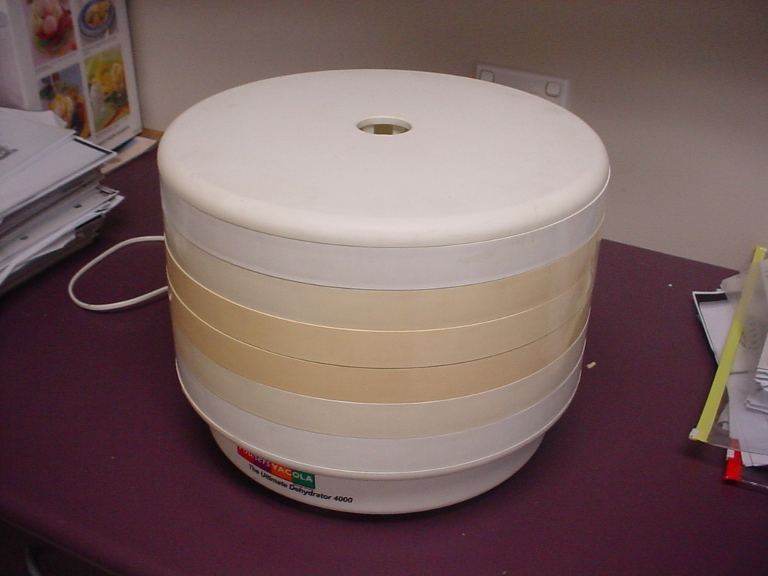
DEHYDRATER
Used for…….

Slide 4
FAIRY FLOSS MACHINE
Used to make………

Slide 5
PRESERVING KIT
Used for …….

Slide 6
BLENDER
Used for…………………

Slide 7
ELECTRIC MIXER
Used for ……………

Slide 8
MAGIMIX
Used for…………….

Slide 9
SCRAPER
Used for…………………..
Made of ……………..

Slide 10
WOODEN SPOON
Used to……….
Made of …………..

Slide 11
RICER
Used to ………………….
To make…………….

Slide 12
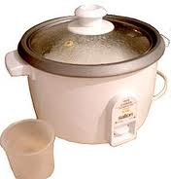
RICE COOKER
Used for …….

Slide 13
BREAD MAKER
Used for ………………….

Slide 14
WOK
Used for …….

Slide 15
PINEAPPLE CORER
Used for …………….

Slide 16
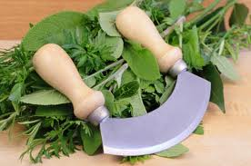
ROCKER KNIFE
Used for……….

Slide 17
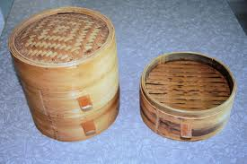
BAMBOO STEAMER
Used for………………………….

Slide 18
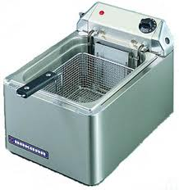
DEEP FRYER
Used for ……….

Slide 19
KITCHEN AID
Used for…………

Slide 20
Research
The following equipment is for you to research and discuss as a group each group of 4 will have two pieces and will give the rest of the class a 3 minutes talk

Slide 21
?
?

Slide 22
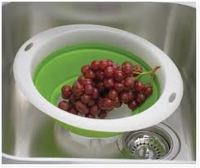
?
?

Slide 23
?
?

Slide 24
?
?

Slide 25
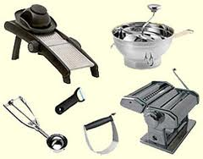
??????
?

Slide 26
?
?

Slide 27
?
?

Slide 28
?
?

Slide 29
?
?

Slide 30
?
?

