Slide 1
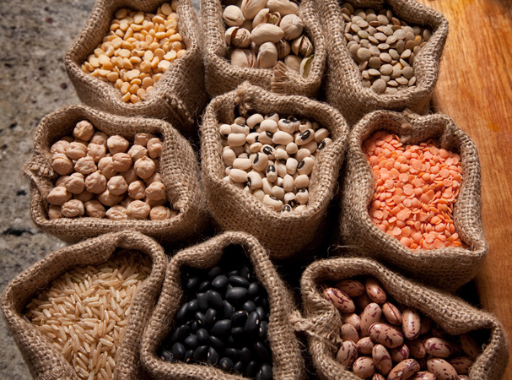
NUTS & LEGUMES

Slide 2
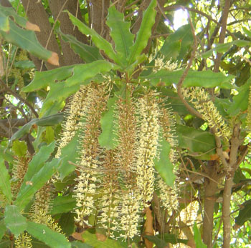
Origin of Nuts
Nuts are from plants they are the edible kernel in a hard shell, grown on matured trees.
Macadamia Tree

Slide 3
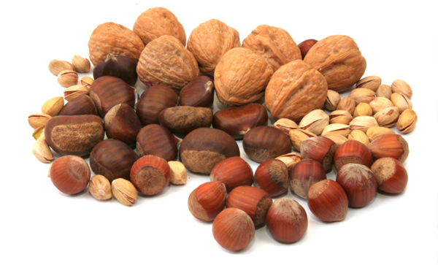
Classification
There are many classifications of nuts;
Examples:
Coconuts, Pecan nut, Almond, Hazelnut Peanut.

Slide 4
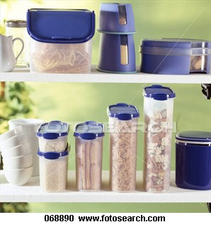
Storage
Keep correctly due to their high
fat content.
KEPT:
Ideally in the refrigerator
Or
In sealed container in pantry

Slide 5
Chemical Properties
Unsaturated fat 40-70%
Protein (incomplete)
Carbohydrates
Consume about a handful of nuts per day

Slide 6
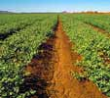
Origin of Legumes
Legumes are from plants they are the seeds from pod-bearing plants.
Pulses are matured legumes, which are dried.

Slide 7
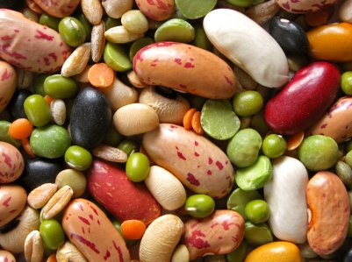
Classification
There are many classifications of Legumes;
Examples:
Lentils, soybeans, chickpeas, kidney beans.

Slide 8
Storage
Can be bought in many different
ways including:
Canned, dehydrated, vacuum packed and as
products such as hummus or soymilk.
Ideally stored In sealed container in pantry, until opened.

Slide 9
Chemical Properties
Protein (incomplete)
Does not contain all 8 essential amino acids… must be combined with other amino acid sources to create complete protein.

Slide 10
Chemical Properties
Carbohydrates- resistant starch
Good for good bowel health
Helps us keep regular
Helps reduce blood cholesterol levels.

