Slide 1
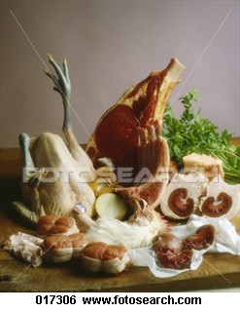
MEAT, Poultry & Seafood

Slide 2
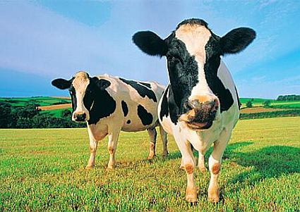
Origin
MEAT IS FROM ANIMALS, it is the edible flesh of animals.

Slide 3
Structure
Meat consists of muscle fibre, fatty tissue and bone.
The muscle fibre is surrounded by connective tissue made up of collagen and elastin.

Slide 4
Classification
Cattle – beef and veal
Sheep – lamb and mutton
Pig – pork and ham
Poultry – turkeys, ducks, quail and chickens
Seafood – White fish – snapper, flathead
- Oily fish – tuna, salmon
- Shellfish – lobster, crabs, prawns

Slide 5
Quality Considerations
Age of animal – younger more tender (think lamb/mutton)
Part of animal used- the greater a muscle is exercised the tougher it will be. It is important to choose the most appropriate cooking method for each cut.

Slide 6
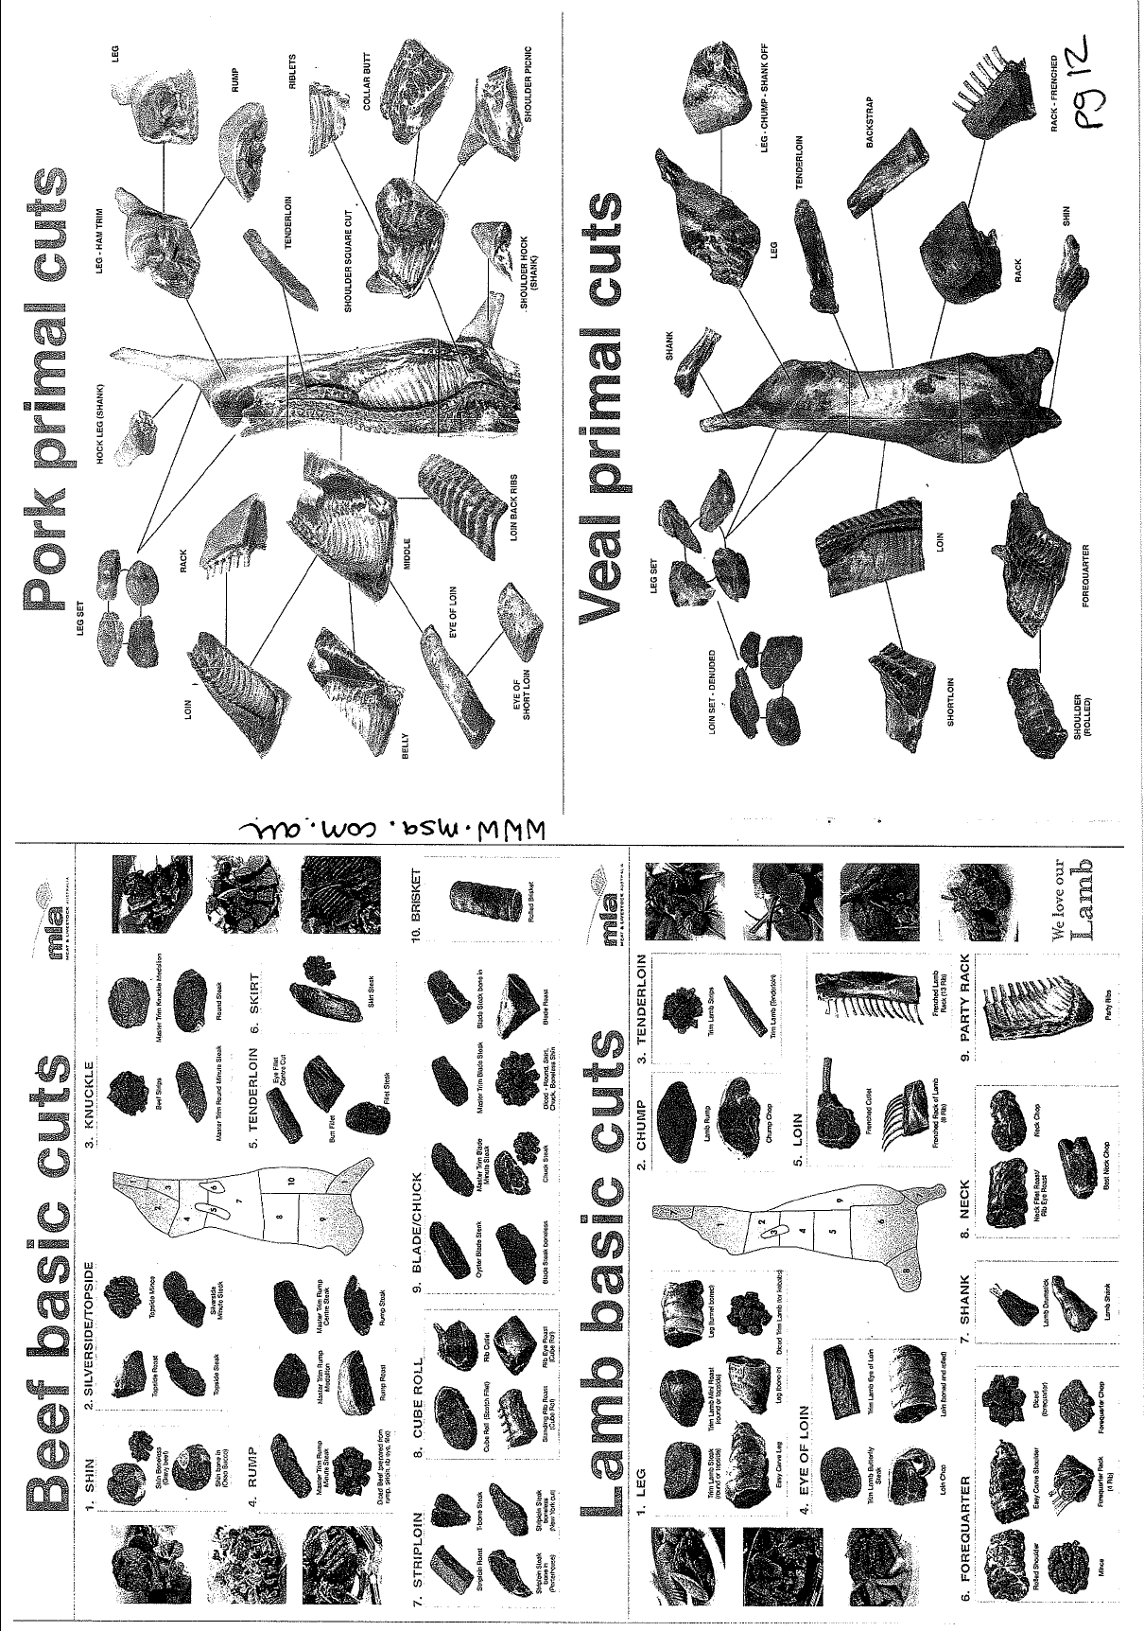

Slide 7
Chemical Properties
NUTRIENT COMPOSTION OF RED MEAT
Protein all essential amino acids
iron
zinc
vitamin B12
Saturated fats
Collagen – structural protein in meat, forms gelatin when heated in water (if using dry heat, toughens)
NUTRIENT COMPOSTION OF POULTY
Lower in iron and fat (remove skin).
NUTRIENT COMPOSTION OF SEAFOOD
Omega 3 fatty acids – good fat

Slide 8
Functional Properties
Denaturation – loosening of bonds, unwinding protein molecules to form a new shape from heat, mechanical action of addition of acids.
Coagulation – occurs when proteins are heated or agitated and are changed from a liquid to a solid (making meat firmer).
=
Tender and Juicy.
Maillard Reaction – The reaction that occurs from the sugar and protein when dry heat is applied, browning the meat.

Slide 9
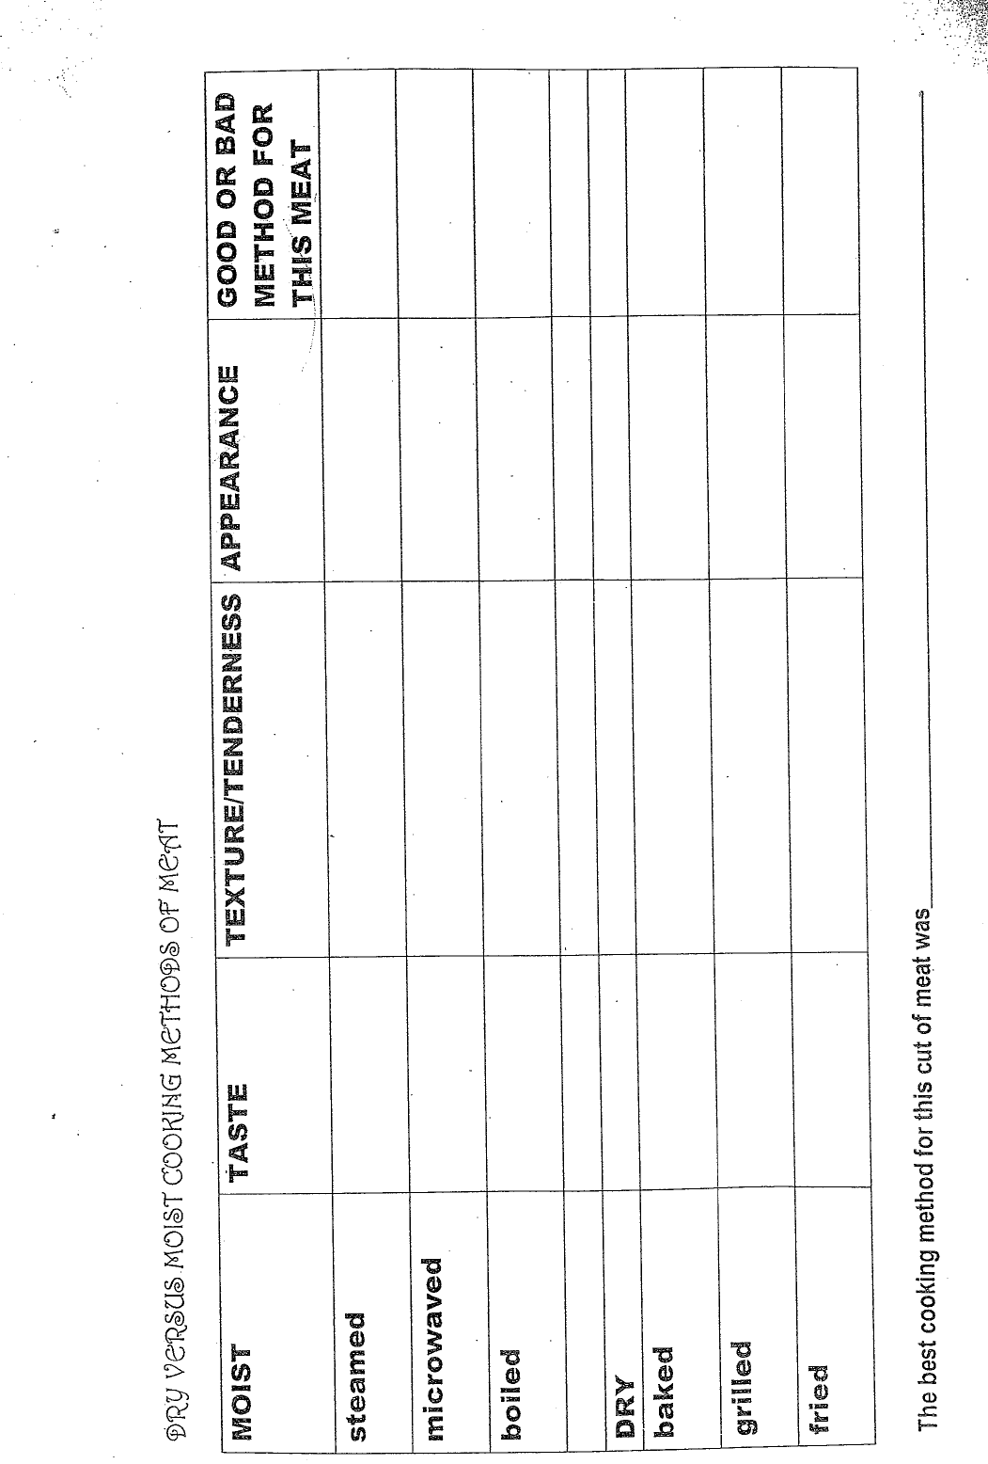

Slide 10
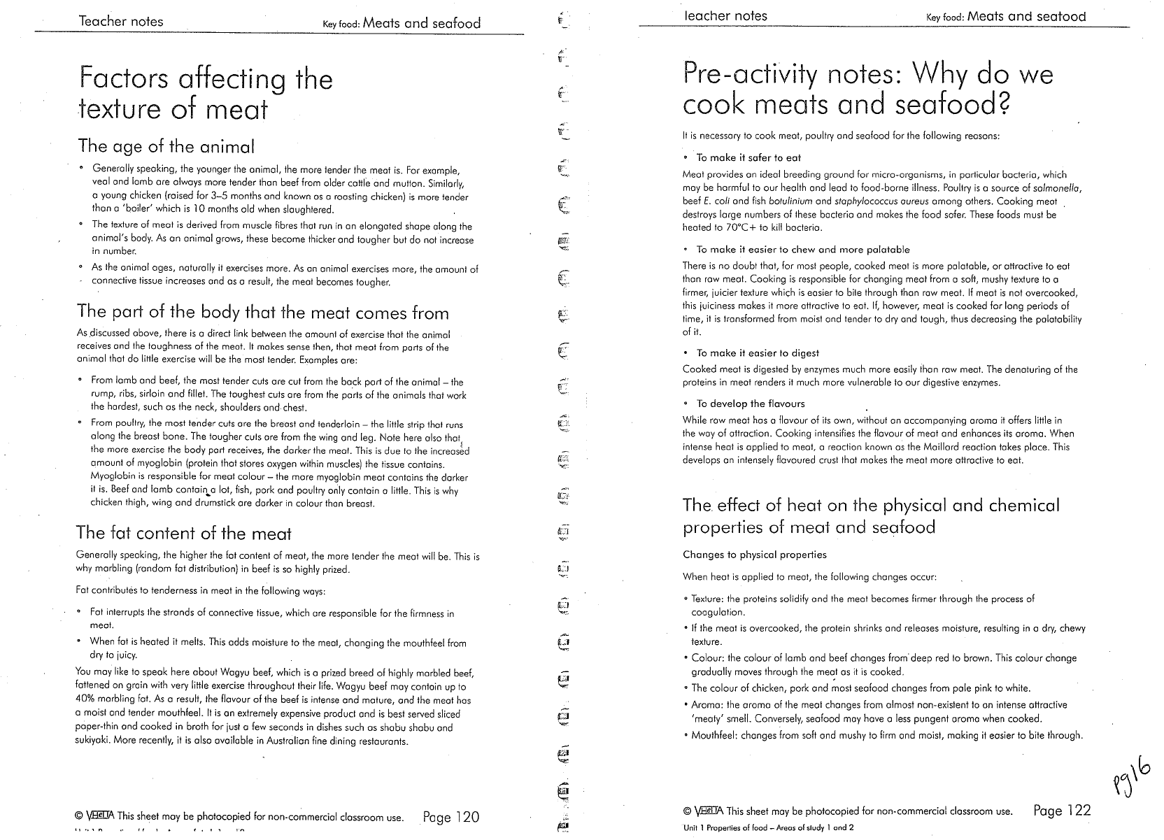

Slide 11
