Slide 1
Functions of natural components in food
Acids, Alkali, Enzymes, Protein, Starch, Sugars, Fats and Oils
Mount St Joseph Girls College
T. Nicholls – Food & Technology

Slide 2
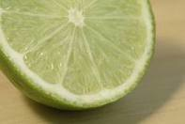
ACIDS & ALKALIS - ACIDS
Acids: are any chemicals that release hydrogen ions when dissolved in water.
They have a sour taste or acidic flavour.
When tested with blue litmus paper, they turn red and have a pH reading below 7.

Slide 3
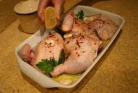
ACIDS – FUNCTION OF ACIDS IN COOKING
How do marinades tenderize meat?
Marinades are added to meat before cooking to break down the connective tissue and convert the collagen to gelatine.
Acids such as wine, vinegar and lemon juice are combined with flavourings.
The acid increases the rate at which the collagen is converted to gelatine and therefore the meat is more tender when cooked.

Slide 4
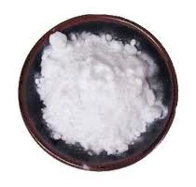
ALKALIS
Alkalis: are the opposite to acids, and are sometimes known as bases.
They have a very low concentration of hydrogen ions when dissolved in water.
Their pH values are higher
than 7 and they turn red litmus
paper blue. Alkalis have a
bitter taste and a slimy mouth
feel.

Slide 5
ALKALIS – FUNCTION OF ALKALIS IN COOKING
How does bicarbonate of soda act as a raising agent?
The most common alkalis used in food preparation are bicarbonate of soda. This is the simplest form of a chemical raising agent.
It is pure white powder that on heating produces sodium carbonate, steam and carbon dioxide.
The carbon dioxide gas is releases and leavens the mixture by causing it to froth and expand up and out.
The residue is soda, which gives a sharp bitter taste and a dark yellow colour.

Slide 6
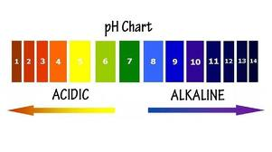
What is the significance of a pH value?
pH is a measure of the acidity of a solution.
The ‘p’ stands for potenz (the potential to be’ and the ‘H’ stands for hydrogen).
pH is measured on a scale of 1-14. this scale is used by food scientists when analysing food products or developing new recipes.

Slide 7
ENZYMES
All raw foods contain enzymes that enable chemical reactions to occur.
The enzymes in fruit and vegetables are responsible for the ripening process.
The other enzymes act on food components to create a new product e.g. when the enzyme rennet is added to milk the curds and whey separate and curds are formed to make cheese.
Enzymes are proteins that cause chemical reactions to take place without changing themselves.

Slide 8
ENZYMES AT WORK!
Banana ripening time lapse
http://www.youtube.com/watch?v=OXkUKQwTrnU
Strawberries ripening on vine
http://www.youtube.com/watch?v=V2nRCc96vHM
Fruit and vegetable decomposition
http://www.youtube.com/watch?v=c0En-_BVbGc

Slide 9
ENZYMATIC BROWNING
When fruit or vegetables are peeled or cut, enzymes are released.
When in contact with oxygen these enzymes form brown pigments called melanins. This is called enzymatic browning.
To overcome this problem, the cut fruit or vegetable is coated with an anti-oxidant. Citric acid from lemon juice is often used to prevent browning.
Banana, why did you turn brown (“Somebody that I used to know”)
http://www.youtube.com/watch?v=XD-9P1Q7Hfo

Slide 10
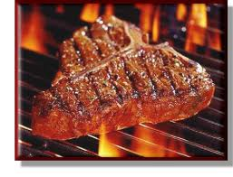
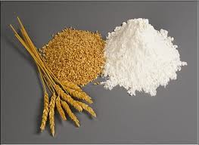
PROTEIN
Hydrolysis - Hydrolysis is the breakdown of large molecules into smaller molecules.
For example: When meat is cooked the process of hydrolysis occurs. This process softens the connective tissue and makes the meat tender.
Hydration - Hydration occurs when protein binds with water, strengthening the protein
molecules.
For example: when water is added
to wheat flour it causes swelling of
the proteins to form gluten.

Slide 11
PROTEIN - DENATURATION
Denaturation
The structure of protein changes when heat or mechanical action (beating) is applied.
This process causes the tangled amino acid chains to unravel as peptide bonds are broken.
Denaturation changes the chemical properties of proteins so they become more palatable.

Slide 12
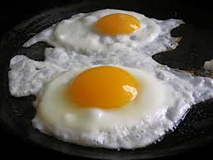
Denaturation of protein in food preparation
Eggs
Heat: the heat coagulates or sets the protein and gives the food product its shape or structure.
Acids: Vinegar is added to poached egg to reduce temperature at which eggs coagulate. This enables the egg proteins to set quickly and retain their shape.
Mechanical action: Aeration partially coagulates the proteins in eggs. The egg white is dentured to form an elastic framework of air bubbles.
Beating egg whites:http://www.youtube.com/watch?v=SEfO4cL-yqM
This trapped air expands when heated in the oven and helps leaven the product e.g. meringues or soufflés.

Slide 13
PROTEIN – COAGULATION
Coagulation
The final stage of denaturation process is coagulation, which results in the setting of the protein.
Liquids containing proteins can change from a liquid to form a gel.
Example – cooking an egg.
Egg coagulation:
http://www.youtube.com/watch?v=y77dNgSbrQI

Slide 14
PROTEIN – The difference between essential & non-essential Amino Acids?
There are essential and non-essential amino acids.
All essential amino acids must be present for humans to form protein in the body.
Non-essential amino acids can be produced by the body.
Essential amino acids cannot be produced by the body and must be consumed in the diet.
Protein foods are classified as complete and incomplete proteins.
Complete proteins contain all the essential amino acids.
Incomplete proteins only contain some essential amino acids.

Slide 15
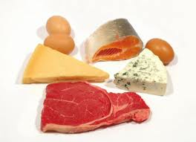
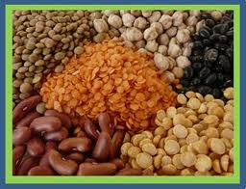
Complete & Incomplete Proteins
Complete protein foods are those that contain all of the essential amino acids. Food examples include: meat, dairy & soy products
Incomplete protein foods only contain some essential amino acids. Food examples include: Most food from plant sources with the exception of soybeans.

Slide 16
CARBOHYDRATES (Starches)
Carbohydrates are made up of glucose.
Starch is the most common carbohydrate found naturally in food.
The classification of carbohydrates is:
Monosaccharide’s – glucose, fructose, galactose
Disaccharides – sucrose, lactose, maltose
Polysaccharides – starch, cellulose

Slide 17
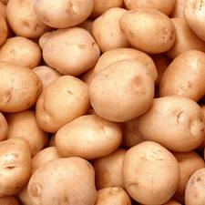
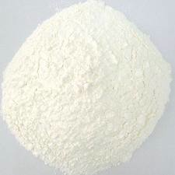
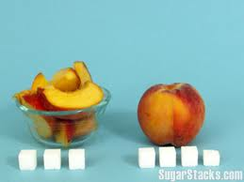
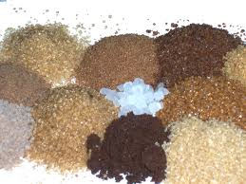
STARCH - Functional properties in food preparation & processing
Starch is bland in taste and abundant in cereals and vegetables.
Potatoes Corn starch
Sugars are sweet to taste and occur naturally in fruits.

Slide 18
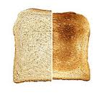
STARCH – DEXTRINISATION
Starches in food preparation and processing:
Dextrinisation: causes a browning reaction in starch foods that can occur. When starch granules are exposed to dry heat, as on the surface of baked vegetables or brown crusts on baked bread.

Slide 19
STARCH – GELATINISATION
Gelatinisation: starch granules are made up of starch molecules.
The granules are large and do not dissolve in water.
If heat (65-70 degrees C) is applied, the starch granule will soften and absorb water.
As the heat is increased the swollen granules burst and the starch molecules disperse through the liquid, thickening it through the process of gelatinisation.
By the time the temperature has reached 90 degrees C the liquid has thickened.
http://www.youtube.com/watch?v=L6vYxYE1jOg

Slide 20
STARCH – GELS & SYNERISIS
Gels: As a gelatinised mixture cools, it can form a gel.
As gels strengthen, synerisis occurs. It is at this point where water is forced out of the gel structure and water seep from the gel.
This occurs when gels are chilled or frozen.
Synerisis – is the process that is the reverse of gelatinisation, forcing water out of the gel structure.

Slide 21
SUGAR – FUNCTIONS IN FOOD PREPARATION & PROCESSING
Increases palatability by sweetening foods & drinks.
Sugars react with protein in a process known as Maillard reaction which results in the formation of a sweet brown substance.
Creaming butter & sugar - To increase volume of flour mixes such as in cakes. How to cream butter & sugar:
http://www.youtube.com/watch?v=mRBX-4KRRkI
To create a finer texture by the even distribution of shortening (butter) in cakes.
To assist with the stability of eggwhite foams & increase their volume by increasing the capacity of foam to hold air.
As a preservative agent in jams or jellies.
To form main structure and texture of confectionary through the process of crystallisation.

Slide 22
CARAMELISATION & CRYSTALLISATION
Caramelisation: http://www.youtube.com/watch?v=CUKhrlklGB0
is the process when sugar solutions or the sugars in fruits are strongly heated. These sugars are converted to a brown substance and are said to have caramelised.
Crystallisation:
Sugar and water solution. When heat is applied more sugar can be added until a supersaturated solution is formed. Water then evaporates, contributing to the solution being concentrated. Crystals form when the solution is cooled. The more crystals that form, the finer the texture of the final product.

Slide 23
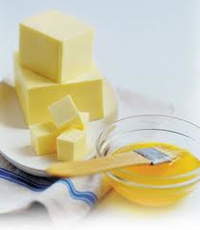
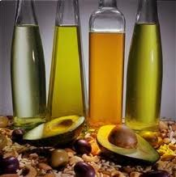
FATS & OILS
Fats and oils have the same chemical structure, but fats are normally solid at room temperature and oils are liquid, depending on the temperature of the room.
Fats and oils can be classified according to:
Their source – animal or vegetable
The way they are distributed in food – visible or invisible
Their chemical composition – saturated or unsaturated
Their state at room temperature – saturated or unsaturated

Slide 24
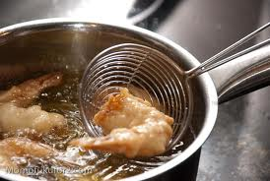
FATS & OILS FUNCTIONAL PROPERTIES
Shortening: Fats provide the shortening for cakes, biscuits & pastries. It is important to choose a fat that provides the right amount of shortening and also provides flavor.
Frying: Fats for frying must be stable at high temperatures. Vegetable oils are a good choice.
Creaming: Fats that are used in cakes must cream well. For this they must have a soft waxy consistency. The functional role of fats in creaming is to keep the gluten strands tender, increase the volume and assist in the aeration of the product.

Slide 25
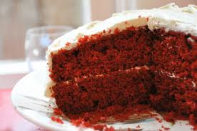
FUNCTION OF FATS & OILS
Products with large quantities of fats and oils, such as baked products, have a moist, often oily texture and smooth mouth feel. The droplets of liquid fat are like tiny balls that roll over the tongue and give the rich, creamy texture to foods high in fats.
Fats and oils enhance the flavours of foods. Butter adds a rich flavour to baked products and flavoured oils such as macadamia and sesame give a distinctive flavour to dressings and sauces.
The pleasant aroma in fried foods comes from the breakdown of fats and oils as they are exposed to heat e.g. food such as potato chips and fried onions.

Slide 26
FATS – WHAT IS AN EMULSION?
Emulsification is the process of dispersing and suspending fats or oils in a liquid medium.
Emulsification is used in food preparation and processing to combine oil with water to make a range of food products.
Examples of emulsions commonly found in food preparation and cooking:
Fat in water emulsion such as milk
Water in fat emulsion, such as butter

Slide 27
FATS – HYDROGENATION
What is the purpose of hydrogenation?
Oils can be made solid by a process called hydrogenation.
During the hydrogenation process, hydrogen is bubbled through the liquid oil and attaches itself to the carbon chain where there is a double bond.
The hardening of the oil makes it possible to produce spreadable fats using vegetable oils extracted from cereals and nuts.
Where is hydrogenation used in food processing?
Used in producing a large range of margarines, spreadable butters and fat spreads on the market.

Slide 28
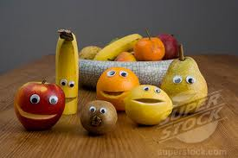
TASK – Update your Glossary
Go through your glossary and add any definitions discussed in this presentation that you haven’t included yet!

