Slide 1
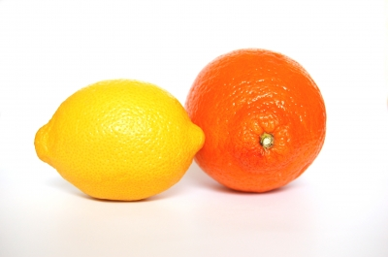
FRUIT

Slide 2
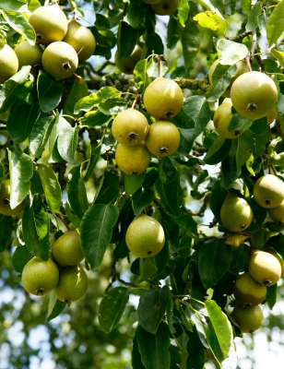
ORIGIN
Fruit are from plants – they are the edible seed or the matured ovary of a flower.

Slide 3
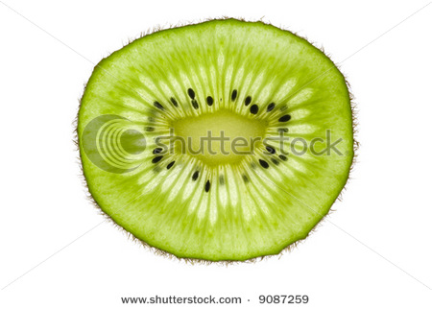
STRUCTURE
Pulp
Fruits consist of three sections:
The Skin
The Pulp
The Seeds
Seeds
Skin

Slide 4
CLASSIFICATION
Fruit are grouped in families according to how they grow and physical properties of the fruit:
Fruit Family | Examples
Pome fruits | Apple, pear, quince
Berry fruits | Blackberries, raspberries, blueberries, strawberries
Stone fruits | Apricots, cherries, nectarines, peaches, plums
Vine fruits | Grapes, kiwifruit, passionfruit
Citrus fruits | Grapefruit, oranges, lemons, mandarins
Melons | Cantaloupes, watermelons,
Tropical fruit | Bananas, mangos, pineapples
Dried fruit | Currant, dates, prunes, raisins, sultanas

Slide 5
SENSORY PROPERTIES
Comparing Raw and Cooked fruit
Colour
Flavour
Texture
Aroma
Fruit can be preserved by: Bottling, Canning, Crystallisation, Drying, Freezing and Jam.

Slide 6
QUALITY CONSIDERATIONS
In Season (best flavour, highest nutritional value and cheapest in price).
Needs to be ripe (or difficult to digest)
Check for blemishes

Slide 7
CHEMICAL PROPERTIES
Mainly made up of nutrients, water and carbohydrates including:
the form of sugar in ripe fruits such as sucrose, fructose and glucose
the for of cellulose, a polysaccharide; not easily digested and forms great dietary fibre.
Great source of Vitamins including the major source of Vitamin C

Slide 8
FUNCTIONAL PROPERTIES
PECTIN (jam making):
Pectin's are the materials that hold the plant cells together.
Pectin gels are formed with sugar and acid. Heating the ripe fruit dissolves the pectic substances; softening the fruit and the pectin's are released in the juices.
The acid and sugar preserve the food and prevent the growth of micro-organisms.

Slide 9
FUNCTIONAL PROPERTIES
Enzymatic browning (apples)
Occurs during ripening
Also occurs when fruit is exposed to oxygen
Prevented by: Increasing acid content or covering the fruit to exclude oxygen

