Slide 1
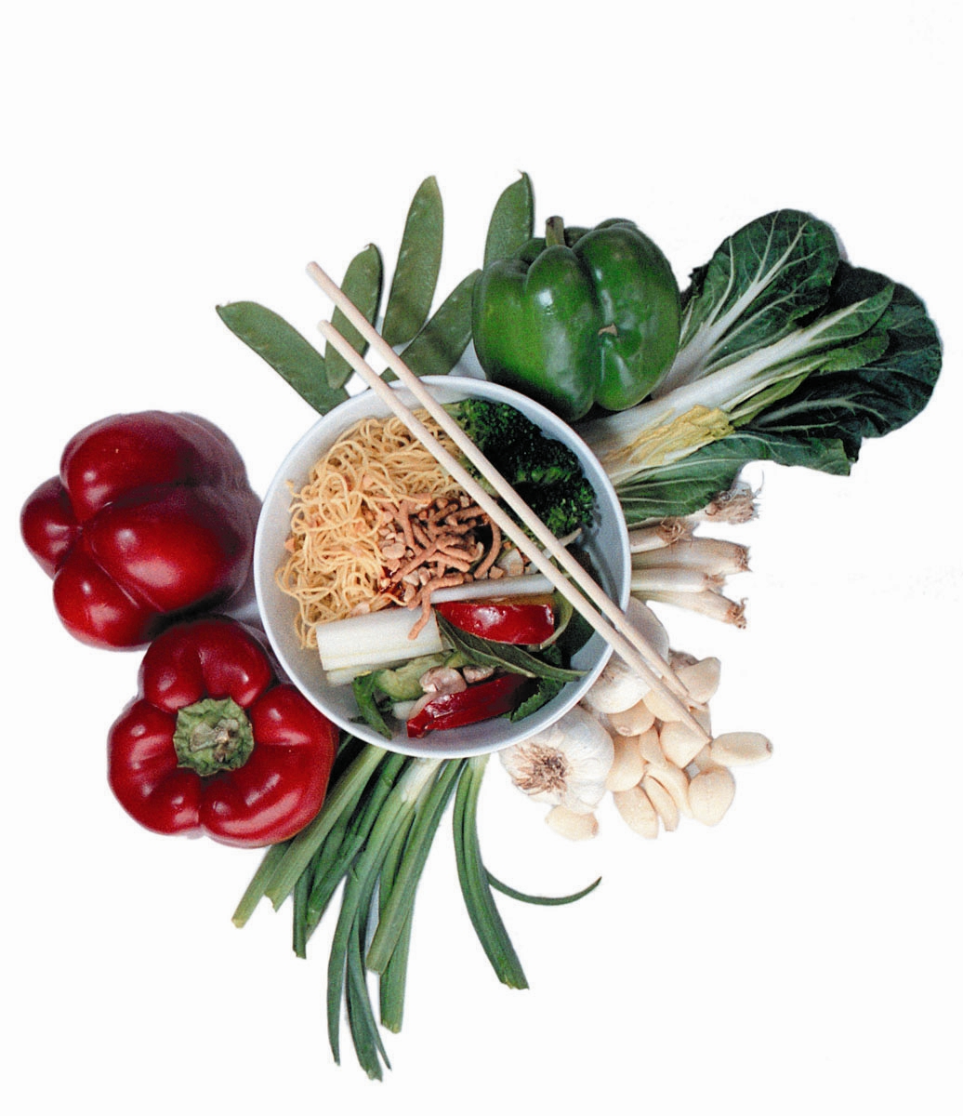
FOOD AND TECHNOLOGY
UNITS ONE AND TWO
2014
www.scscvcefoodtech1and2.weebly.com

Slide 2
Expectations
All Key knowledge tasks to be completed by due dates
Conferencing folders and text book, computer and pens/pencils to be brought to all classes – this includes production classes.
Production tasks are to be completed prior to a practical class otherwise no cooking and these tasks are part of your outcomes
Students must use the website to access tasks
You will be expected to be able to work through self directed tasks from the website
You must get used to accessing our website www.scscvcefoodtech1and2.weebly.com
If work is not submitted by due dates you have to accept staying afterschool on the next day (parents will be contacted) to notify them

Slide 3
Area of study 1
Keeping food safe
Area of study 2
Food properties and preparation
Unit one: Food Safety and Properties of food

Slide 4
OUTCOME 1: KEEPING FOOD SAFE
Key knowledge
principles of food hygiene and safe food handling in a small-scale food operation
Key skills
causes of food spoilage and food poisoning
storage practices to ensure safety and maximise the quality of food
safe and hygienic use of tools and equipment to produce quality outcomes.
identify causes of food spoilage and food poisoning
implement safe and hygienic work practices in a small-scale food operation
•analyse safety and hygiene risk points in food preparation, and identify actions required to eliminate risks
apply understanding of storage techniques that will ensure food safety and maximise the quality of food
select, use, clean and store appropriate food preparation and processing tools and equipment safely.

Slide 5
OUTCOME 2: Food properties and preparation
Key knowledge
Design process
Key skills
Use the design process in preparing foods to optimise properties
Classification of key foods (cereals, fruits, vegetables, nuts and legumes, meat, seafood, nuts and eggs)
Considerations in Food choice
Physical, chemical, and sensory properties of key foods
Functional properties of key foods and their role in food preparation and processing
Changes in physical and sensory properties of key foods
Prepare selected key foods safely and hygienically
To maximise their properties
Identify the major nutrients of selected foods within each of the key food classifications
Make informed decisions and prepare key foods to demonstrate functional properties, compare sensory and physical properties of key foods

Slide 6
End of unit exam
Food properties and preparation
Keeping food safe
Outcome 1
4 key knowledge tasks as requirements for satisfactory completion
SAC as the assessment task for A.O.S
Outcome 2
5 key knowledge tasks as requirements for satisfactory completion
SAC as the assessment task for A.O.S

