Slide 2
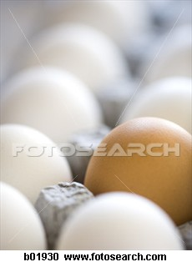
EGGS

Slide 3
EGGS

Slide 4
Origin
The eggs used in food production are hens eggs and therefore of animal origin.

Slide 5
Structure of an Egg
A fresh egg is ovoid in shape and has a cream or brown coloured hard shell. The inside of the egg contains egg while or albumen and an egg yolk attached by the chalaza. A membrane separates the white from the shell. The fresh egg does not have a distinctive aroma.

Slide 6
Classification of Eggs
Cage Eggs - Chickens are kept in cages in a barn.
Free-range Eggs – Chickens roam free outside and have access to barn to lay eggs.
Barn-laid Eggs – Chickens roam free in Barn

Slide 7
Storage conditions
Eggs should be stored in their carton in the refrigerator. They should be packed with the pointy end down.

Slide 8
Checking egg freshness
Check the use by date of the egg carton.
Place the egg in a container of water and observe whether in sinks (fresh) or floats (stale).
Break the egg on a plate and observe the yolk and white. A fresh egg will have a well rounded yolk and a thick layer of white.

Slide 9
Chemical Properties
Very good source of protein
B group vitamins, particularly B12 and vitamins A and D
Minerals: iron and phosphorous

Slide 10
Aeration
Wisk eggs - meringues
Incorporates air into mixture
Egg whites to firm foam:
Bowl must be clean and dry preferably not plastic.
No egg yolk in mixture.
At room temperature.
When the egg white is beaten the protein present stretches and traps the air in a mesh like structure. The egg white increases in volume and becomes a dense white colour.

Slide 11
Coagulation
Process of change in physcial properties of eggs when cooking.
During cooking the white of the egg sets and becomes white and opaque, the yolk becomes firm.

Slide 12
Emulsification
A functional property of eggs.
Eggs stabilise oil and vinegar in suspension, for example in mayonnaise.

Slide 13
