Slide 1
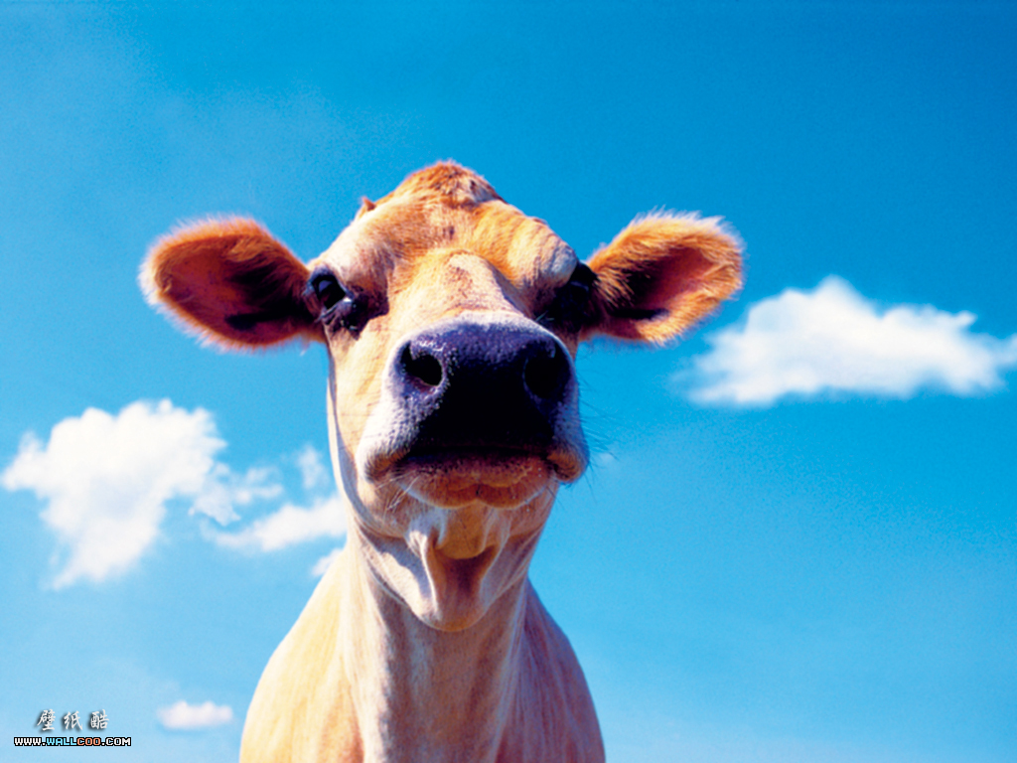
DAIRY PRODUCTS

Slide 2
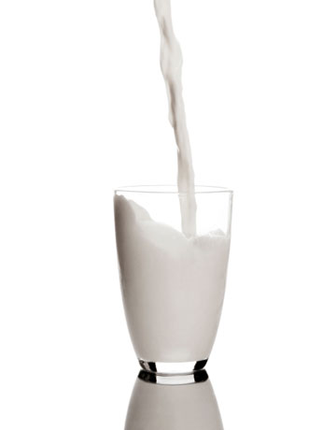
Milk
Most common types:
Cow
Goat
Sheep

Slide 3
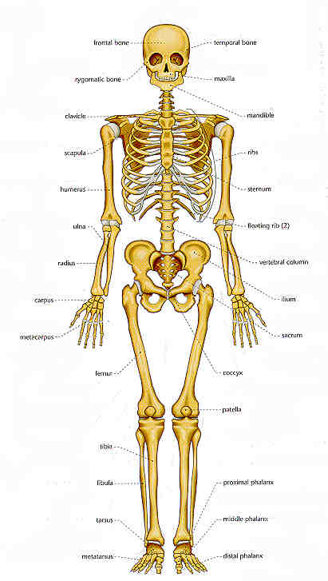
Nutrients - Milk
Mainly water (87%)
Protein
Calcium
Milk fat
Sugar (Lactose)
Vitamin A, C and D

Slide 4
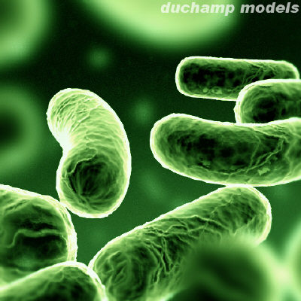
Processing of Milk
Pasteurisation:
Destroys all pathogenic bacteria, or disease causing bacteria.
Involves milk being heated to a high temperature (72 degrees) for 15 seconds and then cooled rapidly (to 4 degrees).
This process destroys all bacteria and has a limited effect on the flavour.

Slide 5
Homogenisation
Involves breaking down the fat globules into minute particles (about one quarter of their original size) so that the cream does not rise to the surface.
It also involves forcing the milk through a very fine nozzle at high pressure.
Homogenised milk is whiter in colour and has less flavour.
Most milk today is both pasteurised and homogenised.

Slide 6
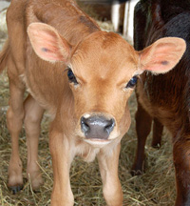
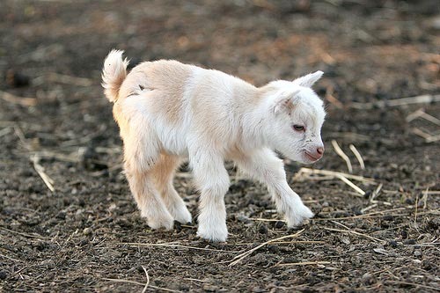
http://www.youtube.com/watch?v=r0rCEBPgo5Q

Slide 7
Selection and Storage
Always check the USE BY DATE of milk to ensure it has a long shelf life.
It should not have a sour odour and should be free of ‘lumps’.
Milk should be stored in a refrigerator at 4 degrees as a higher temperature is likely to shorten the life of the milk.
Milk does not freeze well and will take on a curdled appearance once defrosted.
UHT milk can be stored in the pantry unopened for six months – once opened however, it must be kept in the fridge.

Slide 8
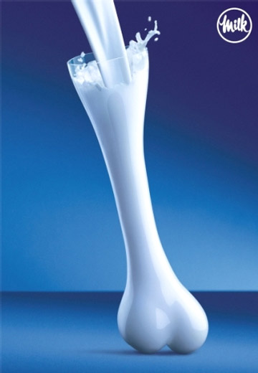
Functional Properties of Milk
Provides moisture
Hydrates starch – so gelatinisation can occur, think about a roux (white sauce)
Extends shelf life of products – Helps reduce staling
Provides a rich flavour

Slide 9
Preparing and cooking with milk
When milk is heated – some of the water is evaporated as steam and the fat globules rise to the top making it creamy in colour.
A skin can form on top of the milk as a result of two proteins reaching the surface due to evaporation (to avoid this skin, stir gently whilst heating)
Milk that is overheated may scorch and burn at the bottom of the saucepan.
Milk boils at a lower temperature (86degrees) than water because it contains more solids.

Slide 10
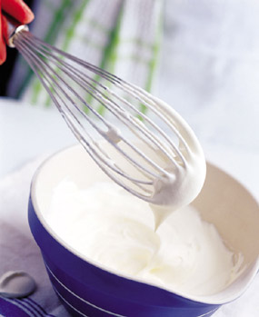
Cream
Cream is a by product of milk and is produced by separating the fat globules from whole milk.
Main nutrients – Fat, Protein, Calcium
Cream is also pasteurised before sale. However, pasteurisation occurs at a higher temperature because is contains more bacteria.

Slide 11
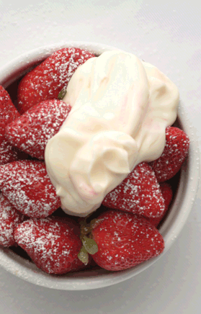
Classifications of Cream
Page 135

Slide 12
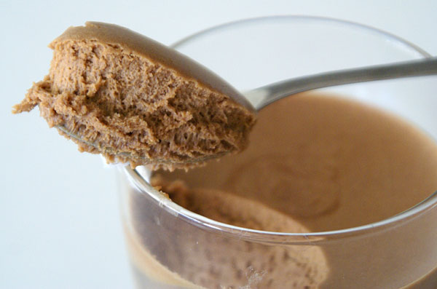
Functional Properties
Adds richness – eg. Soups
Lightens texture – eg. Mousse
Gives contrast in texture – can be whipped etc
Used as a garnish
Whipping: Like eggs whites, cream can be whipped into a stable foam.
Air bubbles are surrounded by a thin layer of protein, a tiny amount of fat is released from the bubbles allowing them to stick together and stabilise.
See diagram and tips in pg 136 of text

Slide 13
Preparing and Cooking
Less likely to form a skin if heated because fat globules have diluted the protein.
More stable than milk, less likely to curdle when combined with acidic or salty foods.
Cream shouldn’t be frozen because the water will separate from the liquid and form ice... This will slightly alter the flavour, make it difficult to whip and give it a grainy texture.

Slide 14
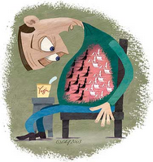
Yoghurt
Mainly made from cow’s milk – can be made from goat and sheep and now soy.
To make yoghurt add a ‘live culture’ (bacteria) to whole or skim milk to begin the fermentation process.
Lactobacillus bulgaricus and Streptococcus thermophilus.
These cultures convert lactose to lactic acid which coagulates the protein making it thick.

Slide 15
Nutritional Properties
Protein
Calcium
Probiotic cultures – acidophilus, Bifidus and L. casei helps to promote health by increasing the level of intestinal flora that live in the gut.

Slide 16
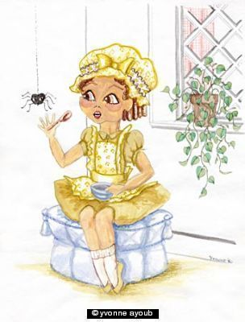
Cheese
Cheese is made from the curds of milk which are separated from the water and lactose or whey.

Slide 17
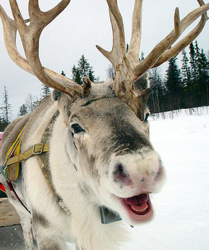
Cheese
Cheese is a concentrated form of milk taking one litre of milk to make 100g of cheese.
Most commonly eaten cheese is made using milk from the cow and goat.
In other cultures the milk from animals that are best suited to the harsher climatic conditions and terrains – reindeer, yak, horses and water buffalo – are used.

Slide 18
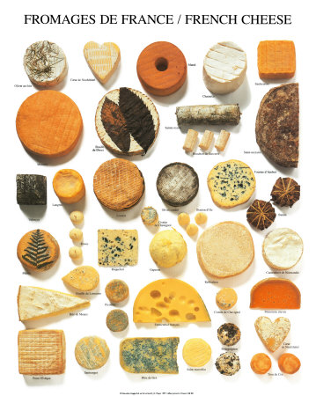
Classifications of Cheese
Cheese can be classified according to the type of milk that is used to make it.
Cow, goat, sheep etc
It can also be classified by:
How the cheese is ripened... Surface-ripened or interior-ripened.
Fat content ... Full cream or low fat.
Firmness/texture... Hard, semi-soft, fresh

Slide 19
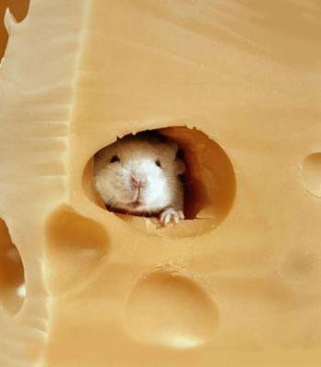
Selecting and Storing Cheese
Cheese generally has a short shelf life.
To maximise storage life, cheese should be wrapped firmly and placed in the warmest section of the fridge.
Fresh cheeses such as ricotta will generally only last for 5 days, whereas hard cheeses such as Parmesan can last for 12 months or longer.

Slide 20
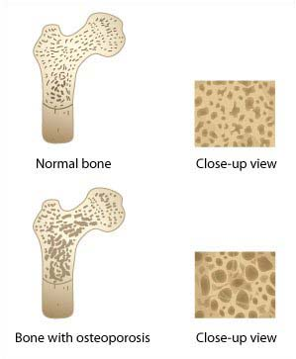
Nutrients - Cheese
High in:
Calcium
Protein
Saturated Fat
Vitamin A

Slide 21
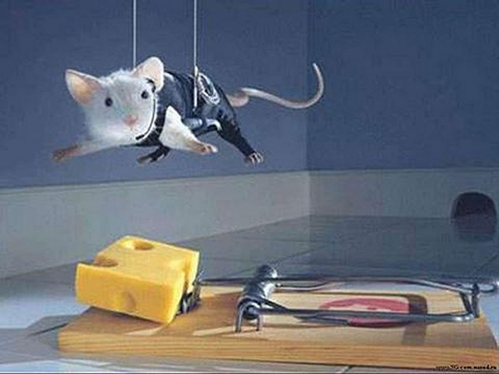
Functional Properties - Cheese
Flavour
Browning
Texture
Volume

Slide 22
QUESTIONS TO ANSWER...
Understanding the text page:134
1, 3, 4, 7 & 8
Understanding the text page: 137
12, 13, 14, 16, 19 & 20
Understanding the text page: 140
23, 24, 26 & 30

