Slide 1
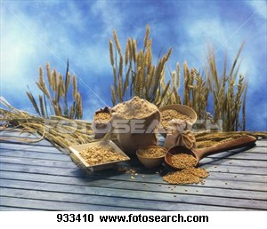
CEREALS

Slide 2
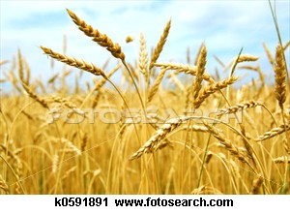
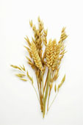
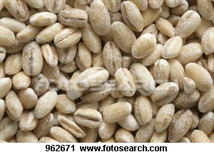
Origin
Cereals are a plant food, that are edible seeds from grasses.

Slide 3
Classification
There are many classifications of cereal crops, these crops are then turned into products used to make dishes.
Example:
Crop | Product | Uses/dishes
Wheat | Flours, couscous, semolina. | Bread, cereals, cakes, pastries, pasta etc

Slide 4
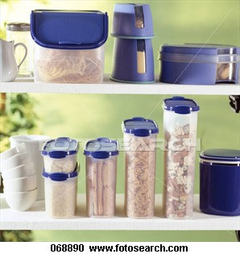
Storage
KEPT:
To moderate level of humidity (DRY)
Ideally between temperatures of 10 and 20 degrees (COOL)
Out of direct sunlight
IDEALLY STORED IN SEALED CONTAINER IN PANTRY

Slide 5
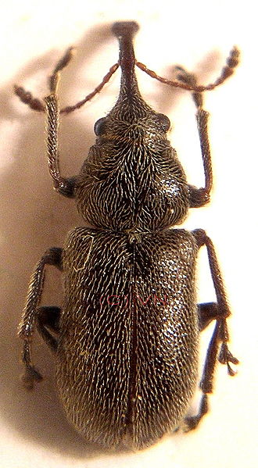
Storage
This way cereals and grains may be stored for longer periods of time without the quality being affected.
By: Bacteria
Pests such as: weevils, ants or rodents.
When buying new stock always use:
‘first in first out system’.

Slide 6
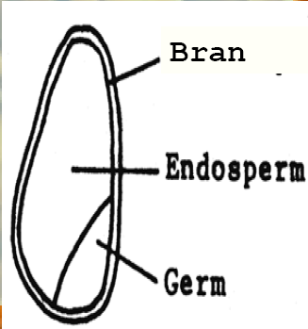
Structure
A cereal grain has three
layers: Husk (usually removed)
Bran
Endosperm
Germ

Slide 7
Structure/ Chemical Properties
Bran: outer layer, provides main source of fibre (complex carbohydrate) in the cereal grain.
Endosperm: Provides the starch (Carbohydrate) in which white flour is produced.
Germ: the reproductive part of cereal and it contains fats, protein (Gluten), carbohydrate and B group vitamins.

Slide 8
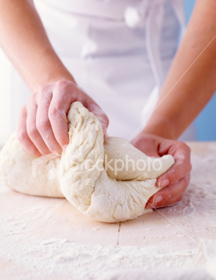
Chemical Properties
Gluten: A protein substance found in many cereal products, including wheat, rye, barley and oats, which gives dough its elastic texture.
It is a very elastic tangle of tiny cords which enables it to provide structural functions in baked products.
When mixed with water the tiny cords stretch and straighten. Gas produced by yeast is trapped by the gluten structure, rising baked products, giving them firmness and shape.

Slide 9
Functional Properties
GELATINISATION: The swelling and consequent thickening of starch granules when they are heated in liquid e.g. Rice –Risotto, Flour- cheese sauce.
Starch + wet heat = Gelatinisation

Slide 10
Functional Properties
DEXTRINISATION: Browning of starch foods when dry heat is applied e.g Bread –Toast, cake tops.
Starch + dry heat = DEXTRINISATION

